Slide 1
Multiple Hypothesis Testing

Slide 2
Doing multiple hypothesises at a p-value of 5% will falsey reject many hypothesis

Slide 3

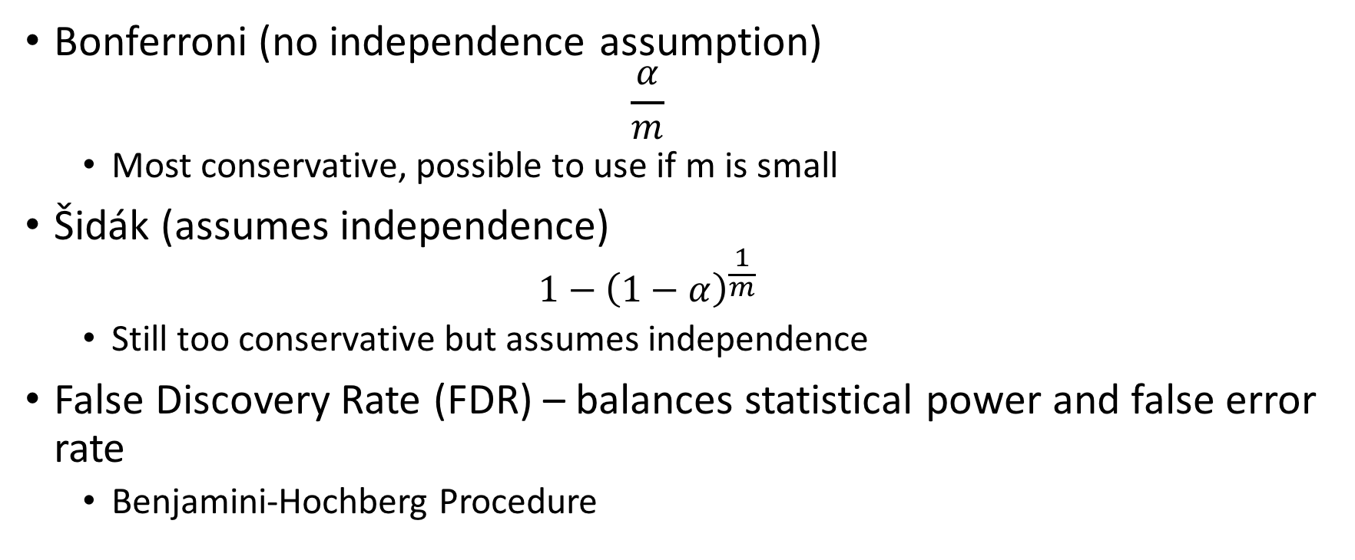
Correcting for $α$
Bonferroni (no independence assumption)
$$\frac{α}{m}$$
Most conservative, possible to use if m is small
Šidák (assumes independence)
$$1−{\left(1−α\right)}^{\frac{1}{m}}$$
Still too conservative but assumes independence
False Discovery Rate (FDR) – balances statistical power and false error rate
Benjamini-Hochberg Procedure

Slide 4
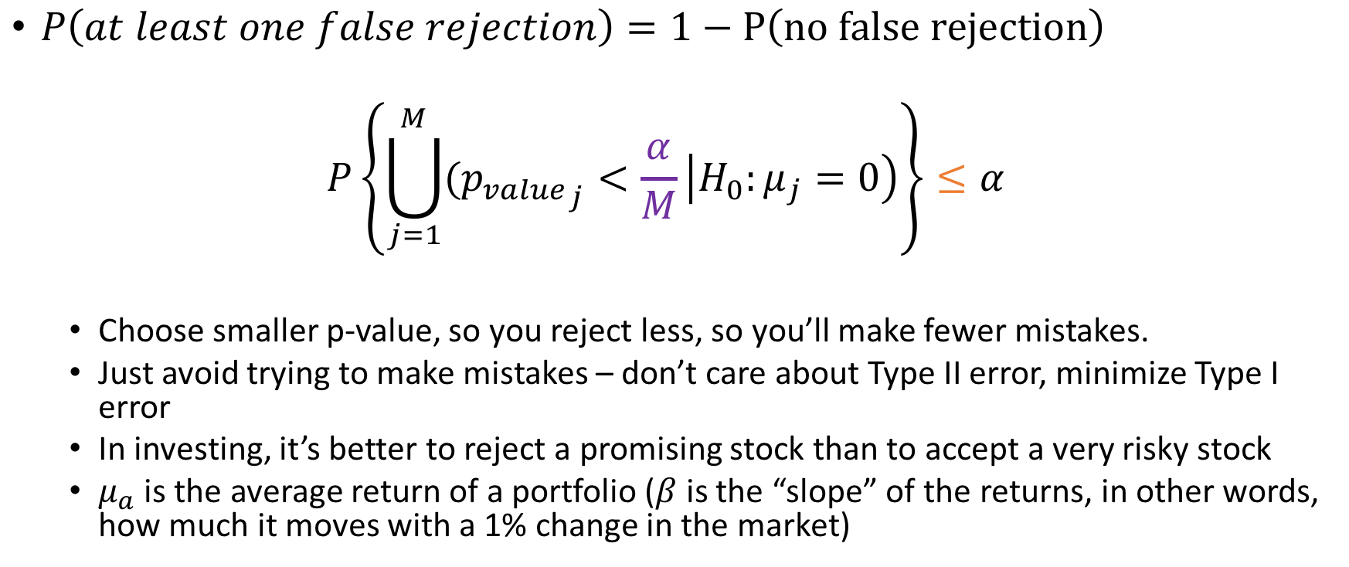
Familywise Error Rate (Bonferroni)
$P\left(at least one false rejection\right)=1−P\left(no false rejection\right)$
$$P\left\{\bigcup_{j=1}^{M}{({p_{value}}_{j}}<\frac{α}{M}\left|H_{0}:μ_{j}=0\right)\right\}≤α$$
Choose smaller p-value, so you reject less, so you’ll make fewer mistakes.
Just avoid trying to make mistakes – don’t care about Type II error, minimize Type I error
In investing, it’s better to reject a promising stock than to accept a very risky stock
$μ_{a}$ is the average return of a portfolio ($β$ is the “slope” of the returns, in other words, how much it moves with a 1% change in the market)

Slide 5
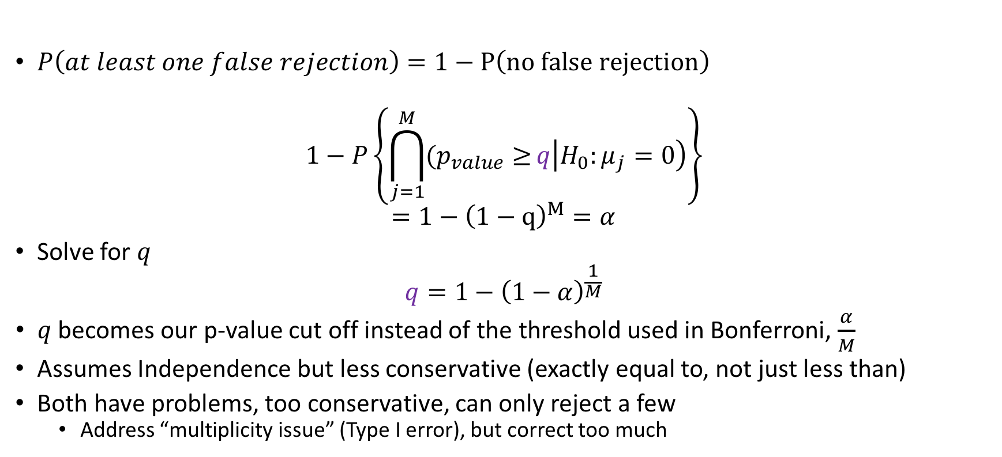
Familywise Error Rate (Sidak)
$P\left(at least one false rejection\right)=1−P\left(no false rejection\right)$
$$1−P\left\{\bigcap_{j=1}^{M}{(p_{value}≥}q\left|H_{0}:μ_{j}=0\right)\right\}$$
$$=1−{\left(1−q\right)}^{M}=α$$
Solve for $q$
$$q=1−{\left(1−α\right)}^{\frac{1}{M}}$$
$q$ becomes our p-value cut off instead of the threshold used in Bonferroni, $\frac{α}{M}$
Assumes Independence but less conservative (exactly equal to, not just less than)
Both have problems, too conservative, can only reject a few
Address “multiplicity issue” (Type I error), but correct too much

Slide 6
False Discovery Rate (FDR)

